Slide 1


Kindling Student Workers for Success
Resumes and Social Media
@rachaelstanley

Slide 2
2014 Facts
8.5 % of new grads are unemployed
16.8 % of new grads are underemployed
Source: “How Bad Is the Job Market for the College Class of 2014?”--Slate.com

Slide 3
How can we help?
1. Be a networking resource after graduation
2. Teach our student workers how to:
  Develop a personal brand
  Write the student job on their resume
  Use Social Media to network
  Search for jobs online
Here’s how...

Slide 4

Why a personal brand?
Be your own PR person
Manage first impressions

Slide 5
Develop your personal brand
Replace resume objective with branding statement
Have a version of the branding statement for “elevator pitch”
Support brand by what you post online

Slide 6

Exercise: What’s my brand?
Who are you?
What can you do?
What job are you looking for?

Slide 7
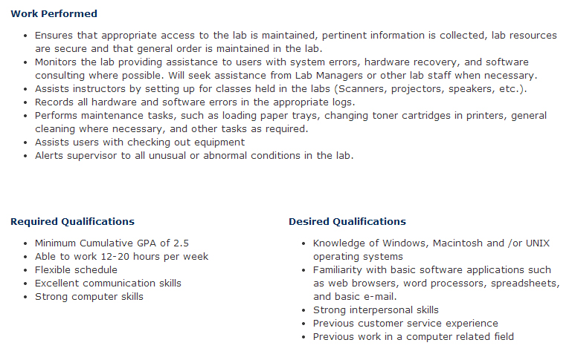
Resume for a Student Worker
The student worker job:
Look at the basic job description
Ask yourself questions
For the supervisor:
Do you have a good job description on the web?
Help your students write what they do on their resume

Slide 8

Resume for a Student Worker
For the student, ask questions:
Did I get commendations?
Did I have duties not listed on the web site?
For the supervisor:
Do you send email/talk to the student when they do something good?

Slide 9

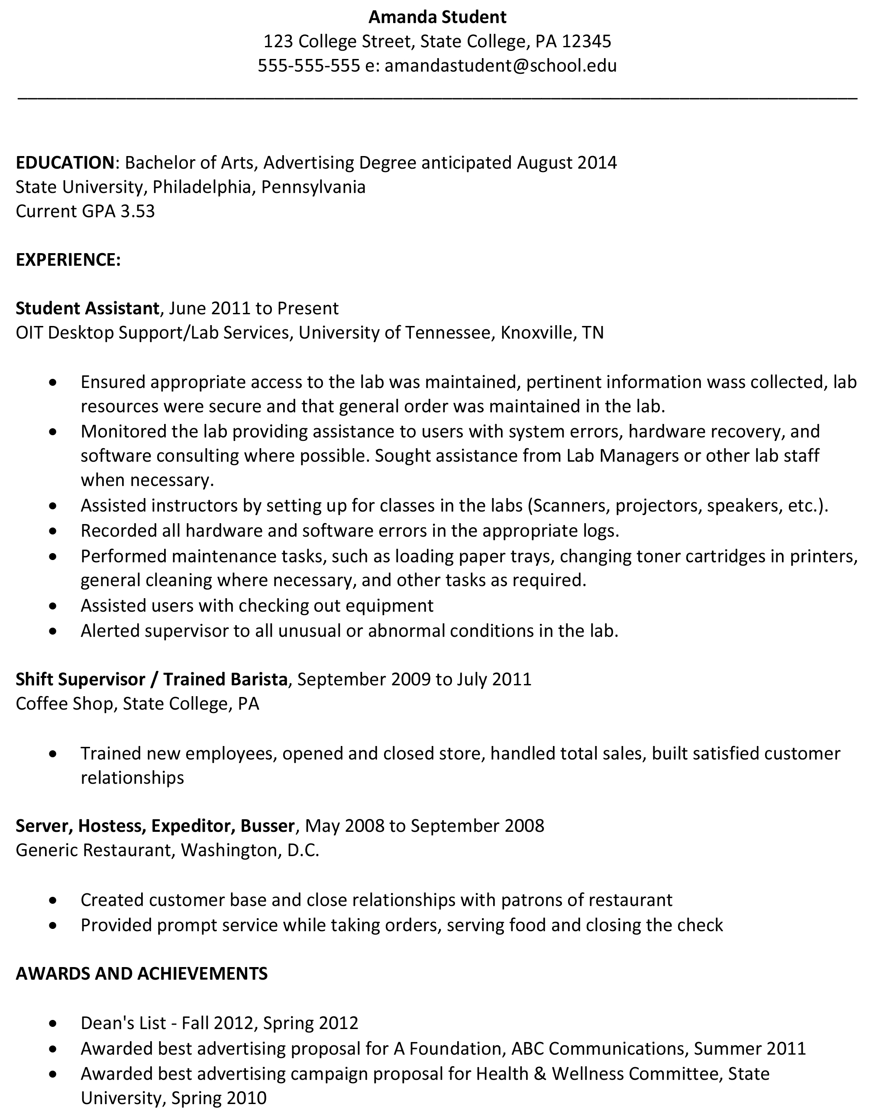
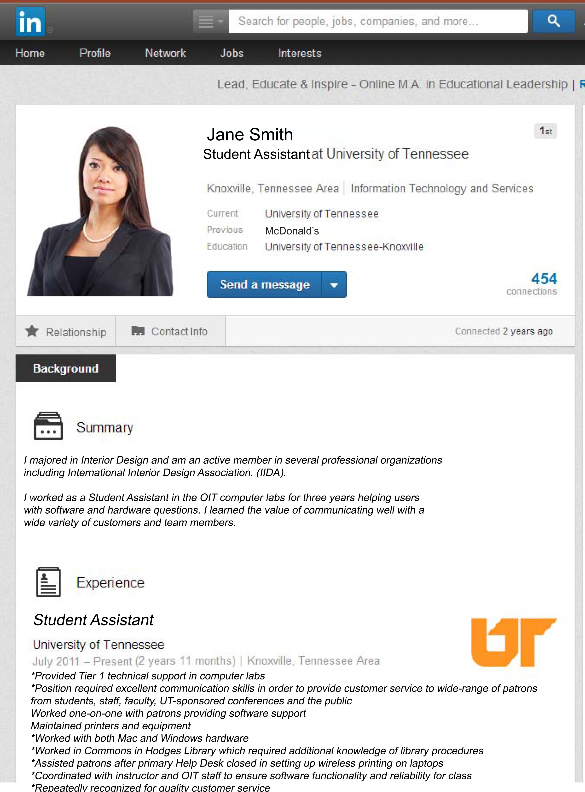
Traditional Styles of Resumes:
Paper
LinkedIn

Slide 10
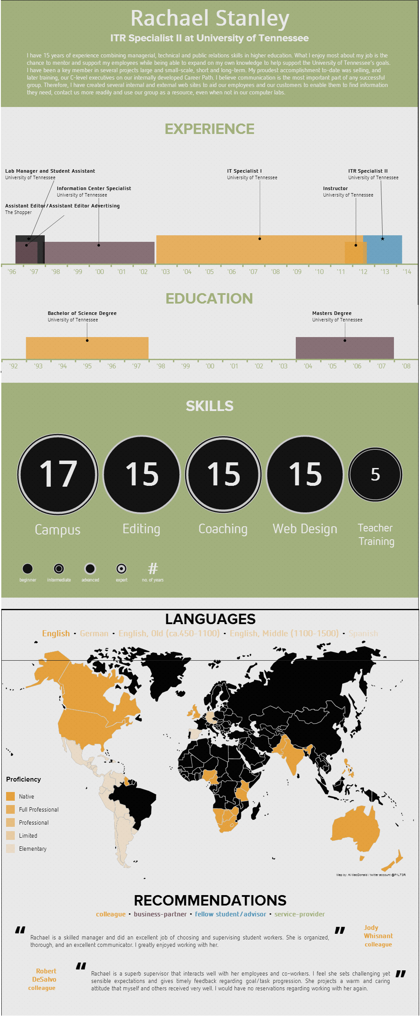

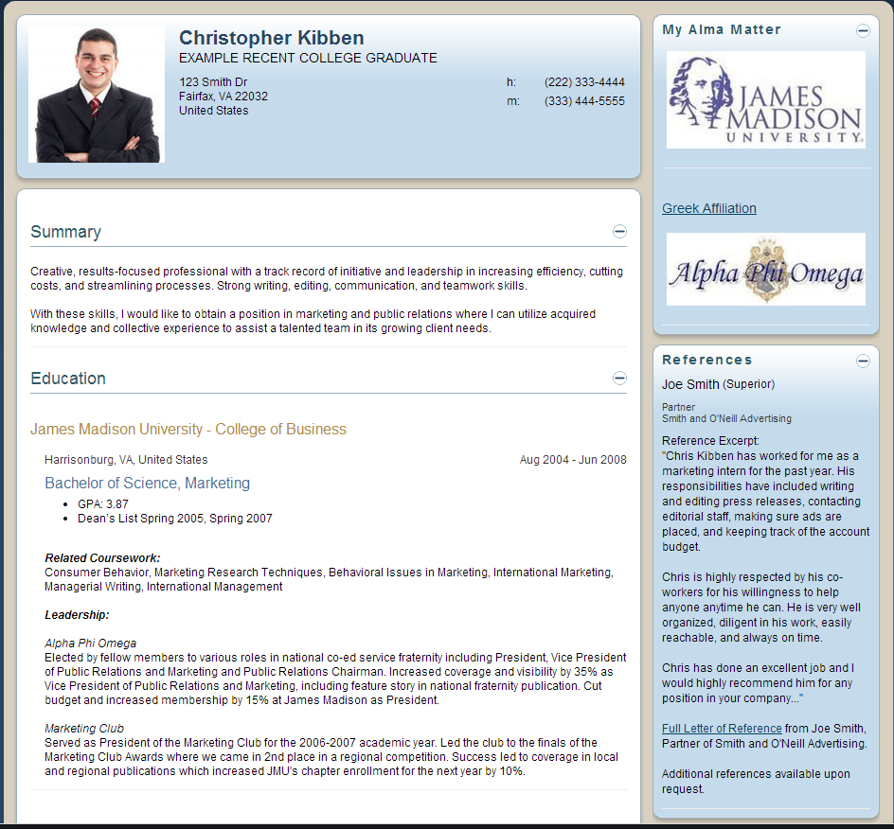

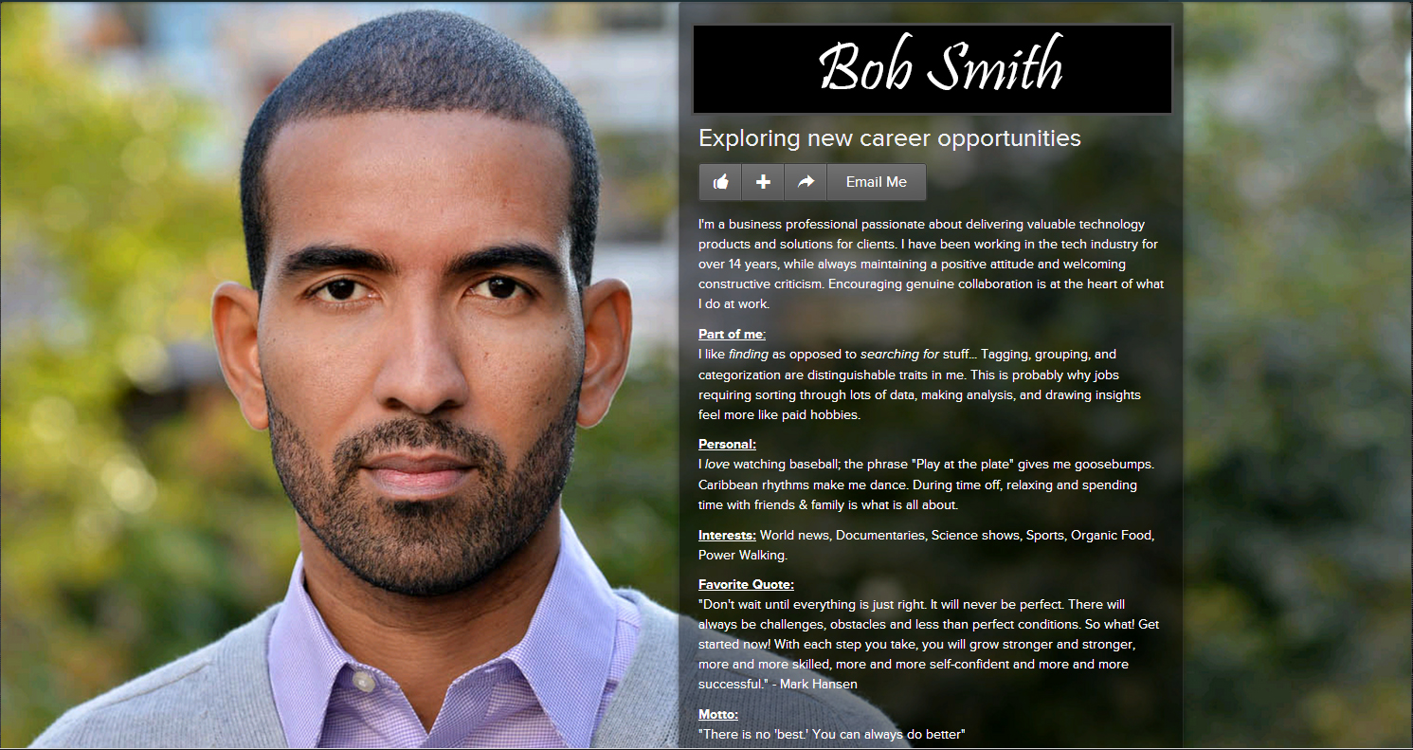

Alternative styles

Slide 11
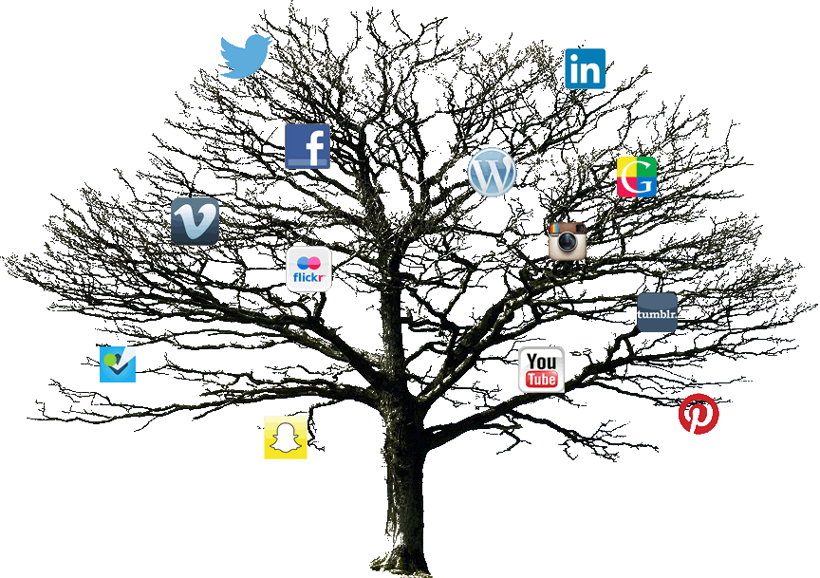
Social Media:
Professional Vs. Personal
Some sites overlap. Keep this in mind.

Slide 12
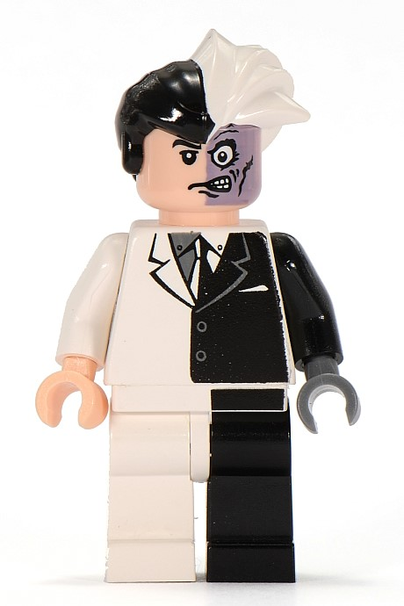
Why use Social Media Networking?
Internship opportunities
Jobs after graduation
Contacts in your field
Get ideas/Give ideas
Establish yourself as an expert
Build confidence networking
Manage your personal brand
Who do you want employers to see?

Slide 13

Know your rights (or lack thereof)
Only in these states is it illegal to ask for your username/password
Maryland
New Jersey
New Mexico
Illinois
Michigan
Utah
California
Other states are considering legislation.
Social Media companies are beginning to help protect their users via usage policies.
Source: “Employer access to social media usernames and passwords” www.ncsl.org

Slide 14

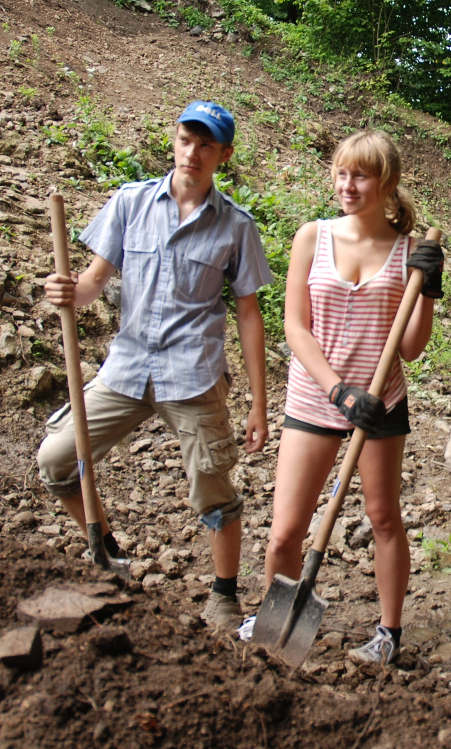
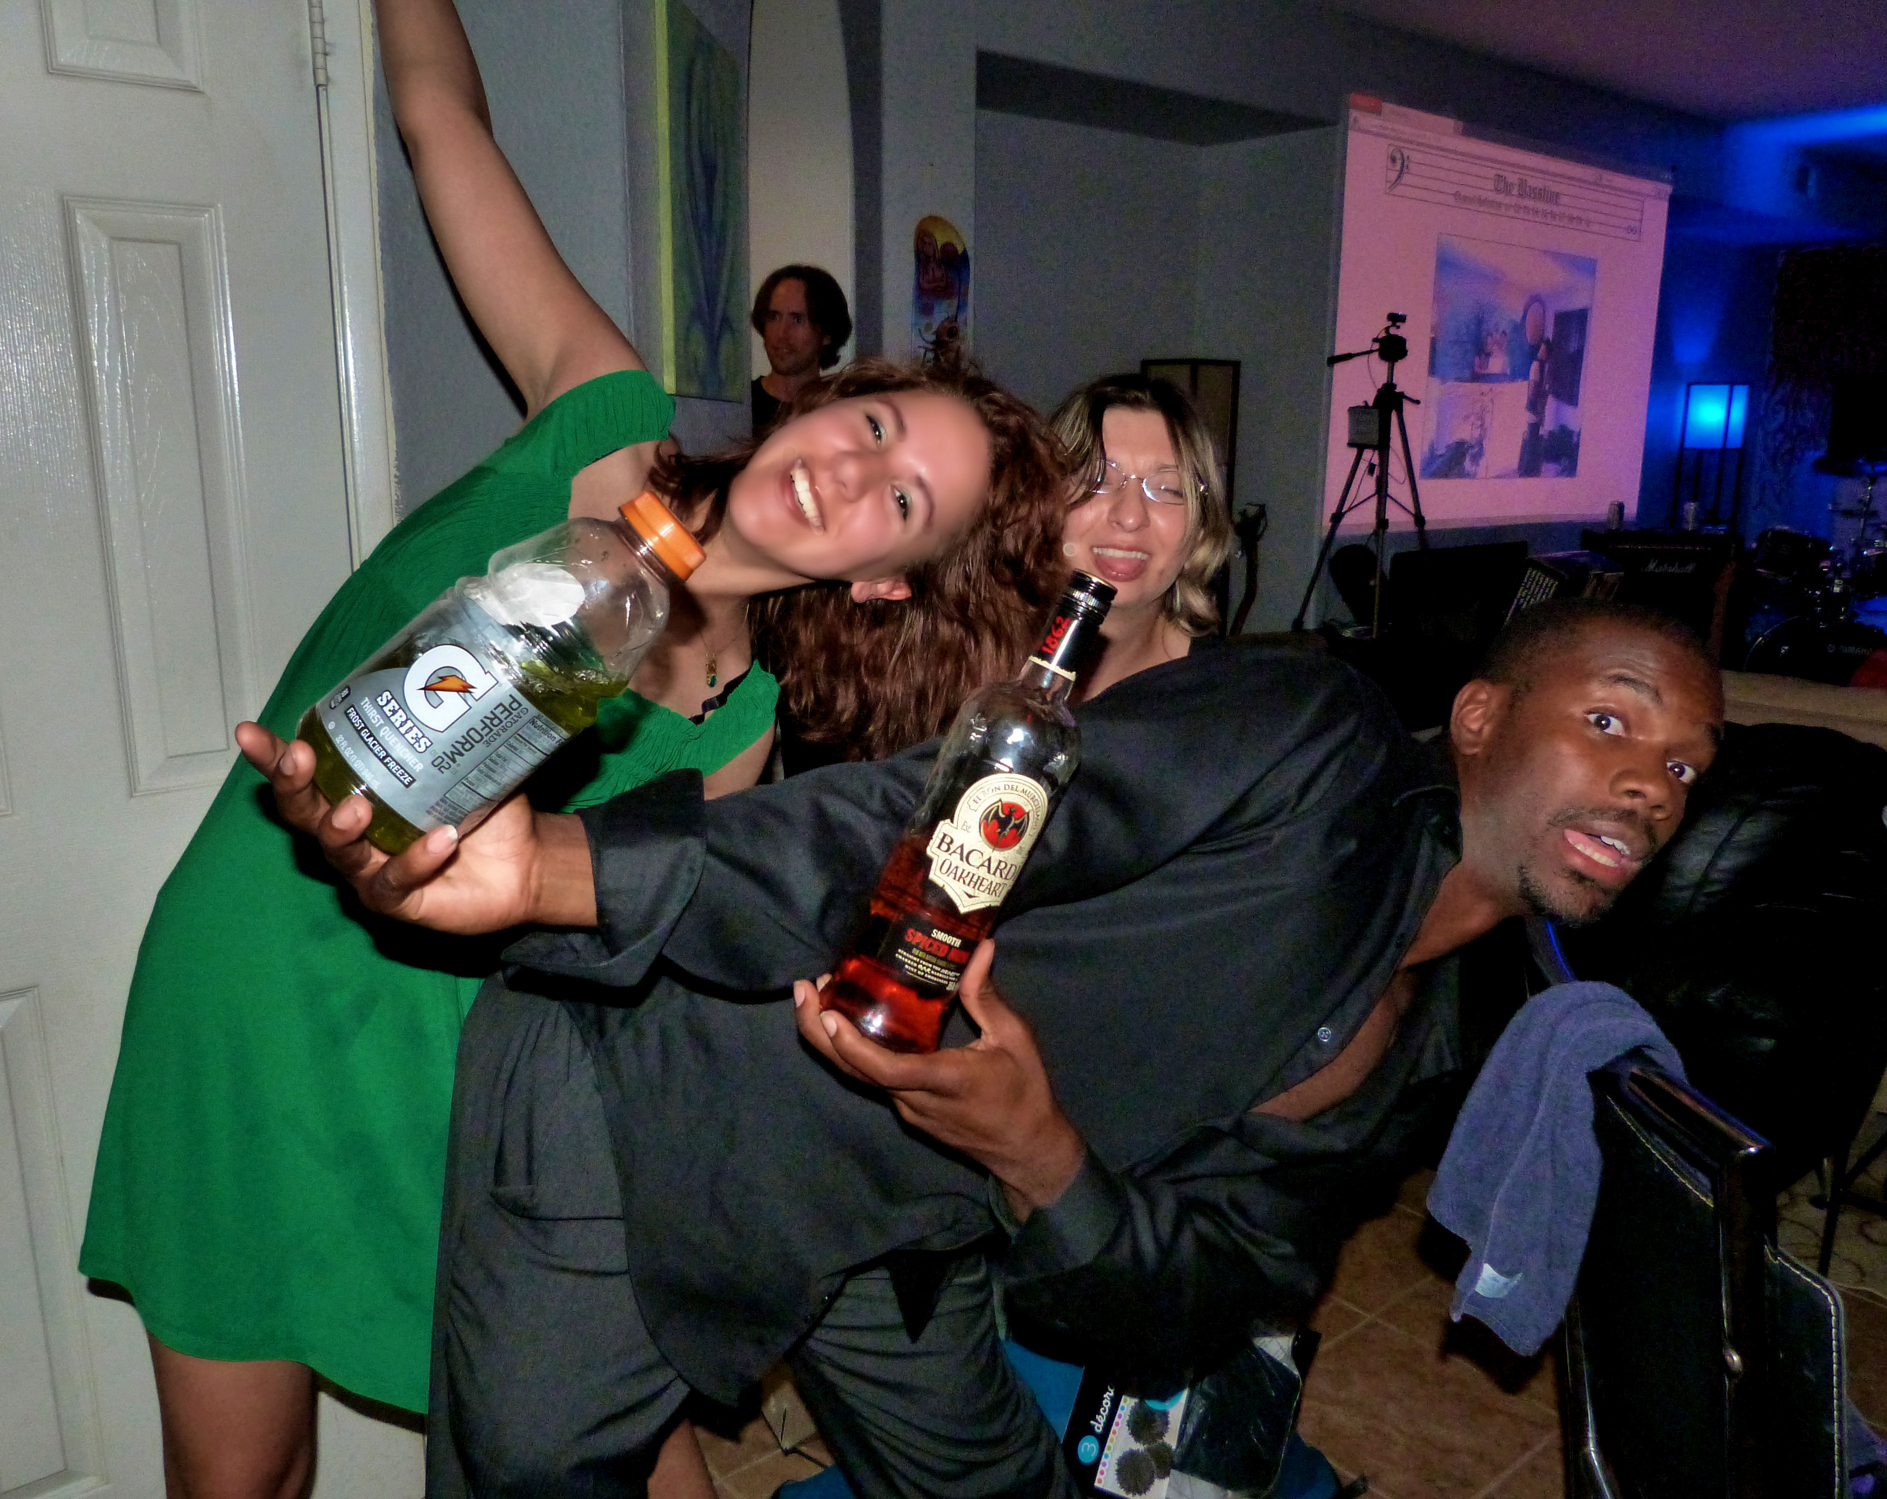

What not to do: Don’t be an idiot
No inappropriate pictures
No confessions
No discriminatory comments
No risky behavior
Show These
Not These

Slide 15

Warning: It’s Forever
For student workers:
You can be FIRED for what you post online
It never goes away
(even Snapchat)
For supervisors:
Keep up-to-date on social media your students are using
Danger, Will Robinson!
From Snapchat Privacy Policy: “In addition, as for any other digital information, there may be ways to access Snaps while still in temporary storage on recipients’ devices, or forensically, even after they are deleted.”

Slide 16

What to do?
Stick to a handful of sites
  Be an expert there
Follow companies you’re interested in
  Participate in their discussions
Actively manage your image
For supervisors:
Set up a networking group for students to join

Slide 17
But Facebook is for my mom!
True, but companies use FB.
Just like with Twitter, you can:
Like their page
Participate on the page
Get familiar with what’s important to that company
Employers will Google you. FB is often a top result. Manage your image there for a good first impression.

Slide 18

Twitter, helpful hints
Tweet often, but not too often
Include pictures
Be a real person
Use humor appropriately
Watch what you say
Follow others, but not everyone
Make sure your followers are real people

Slide 19


LinkedIn Don’ts
Post non-professional messages or images
Make a lot of updates at once
Be annoying in discussions
Obviously self-promote
Nice pictures, close,
but just not professional

Slide 20
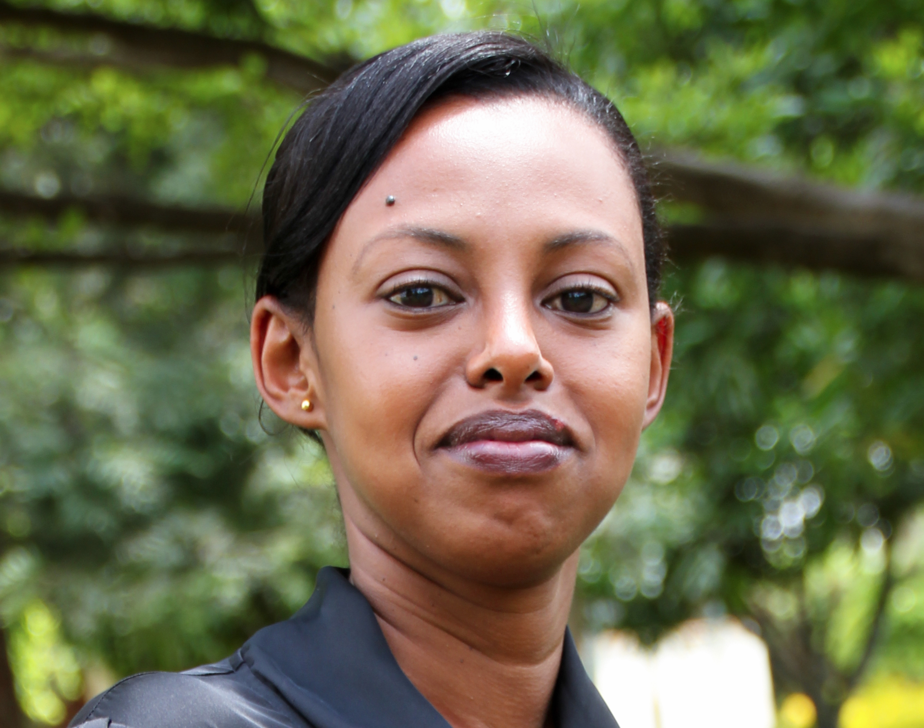

LinkedIn Do’s
Professional looking photo
Get as many REAL contacts as possible
Keep your info updated
Link to papers, blogs, Twitter
Join Groups and participate!
Hair combed, neat clothes, close-up of face

Slide 21






Where to look?
Use reputable job search sites

Slide 22
Ways I network with my students
LinkedIn
FaceBook
Professional way to stay connected
Gives current/former students natural connection
Info for references and background checks
Group and individual connections
UT Computer Labs group
Announcements relevant to current/former students
Way for students to keep in touch if not on LinkedIn
Fun things we’re doing

Slide 23

Bringing it all together
Use accepted professional sites
Use reputable search engines
Get an early presence on new sites
Follow companies you’re interested in

Slide 24

Questions?
Thank you!
rachael@utk.edu
@rachaelstanley

