Slide 1
Resume Writing and
Social Media Networking
2015

Slide 2
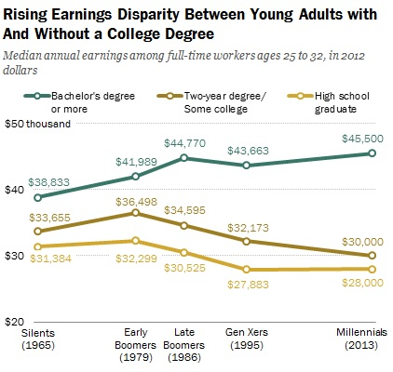
The good news….
Source: The New Bachelor's Payoff, Inside Higher Ed
https://www.insidehighered.com/news/2015/02/11/bachelors-degrees-lead-employment-and-more-training

Slide 3
So why worry about this?
In 2015:
Unemployment Rate for Nation:*
Total for people 16 years and over: 6.7%
Total for Bachelor’s degree and higher: 3.4%
Unemployment Rate for recent college grads:**
People 22-26 years old: 7.5%
*Source: Bureau of Labor Statistics News Release March 6, 2015
http://www.bls.gov/news.release/pdf/empsit.pdf
**From “Hard Times to Better Times,” Georgetown University, Center on Education and the Workforce, 2015 report, pg. 8
https://cew.georgetown.edu/wp-content/uploads/HardTimes2015-Report.pdf

Slide 4
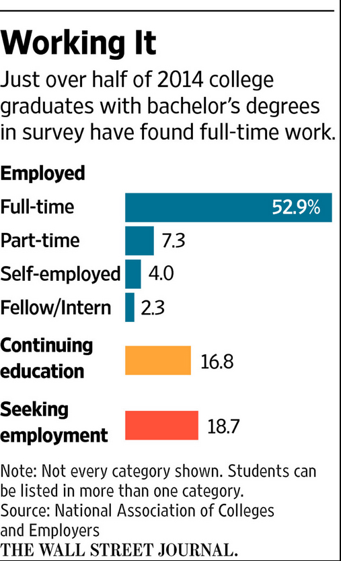
Mixed Signals:
Article: “Job Market Perks Up for Recent College Graduates”
Article: “Job outlook for 2014 college grads puzzling”
Quote from 2012 grad still looking for work:
"It's really scary when I think about my graduating class and how now, two more of those classes have come out and have entered the workforce and that puts me behind them. I feel like I am being set back with every passing day."
Article
emphasis:
Doesn’t
Address:
Source: USA Today
http://www.usatoday.com/story/money/personalfinance/2014/05/18/job-outlook-2014-graduates/8809801/?AID=10709313&PID=6158793&SID=i7geslubk900hryl00dth
Source: WSJ http://www.wsj.com/articles/job-market-perks-up-for-recent-college-graduates-1425013918

Slide 5
So what can you do?

Slide 6

Develop your personal brand
Replace your resume objective with your branding statement
(or remove completely to save space)
Have a version of your branding statement for your “elevator pitch.”
Support your brand by what you post online on professional sites.

Slide 7
What’s my brand?
Who are you?
What can you do for the company?
What job are you looking for?

Slide 8
Craft a great resume and learn how to ask for references

Slide 9
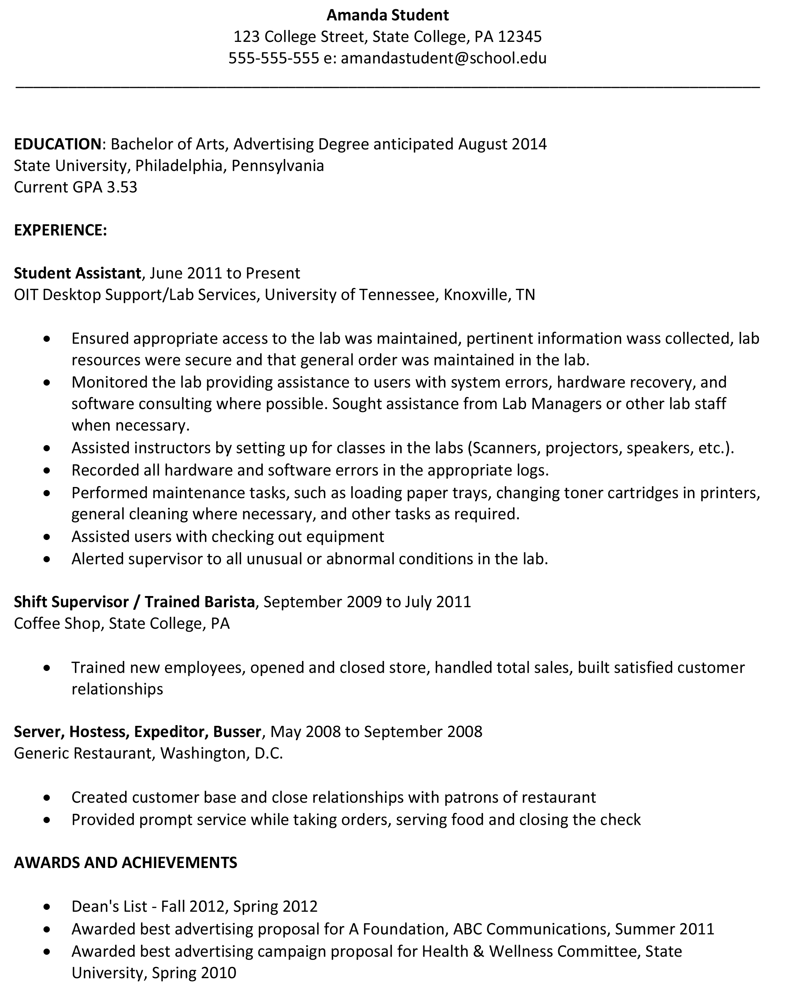
Your Resume: The Basics
Tailor resume for each job
Have different styles
Add job duties
Ask questions

Slide 10
Tailoring your resume
Highlight things pertinent to that job
Use the exact wording from the ad in your resume for requirement key words:
Don’t put: If what was advertised:
Web Design HTML, JavaScript
Accepted finance principles GAAP or IFRS

Slide 11
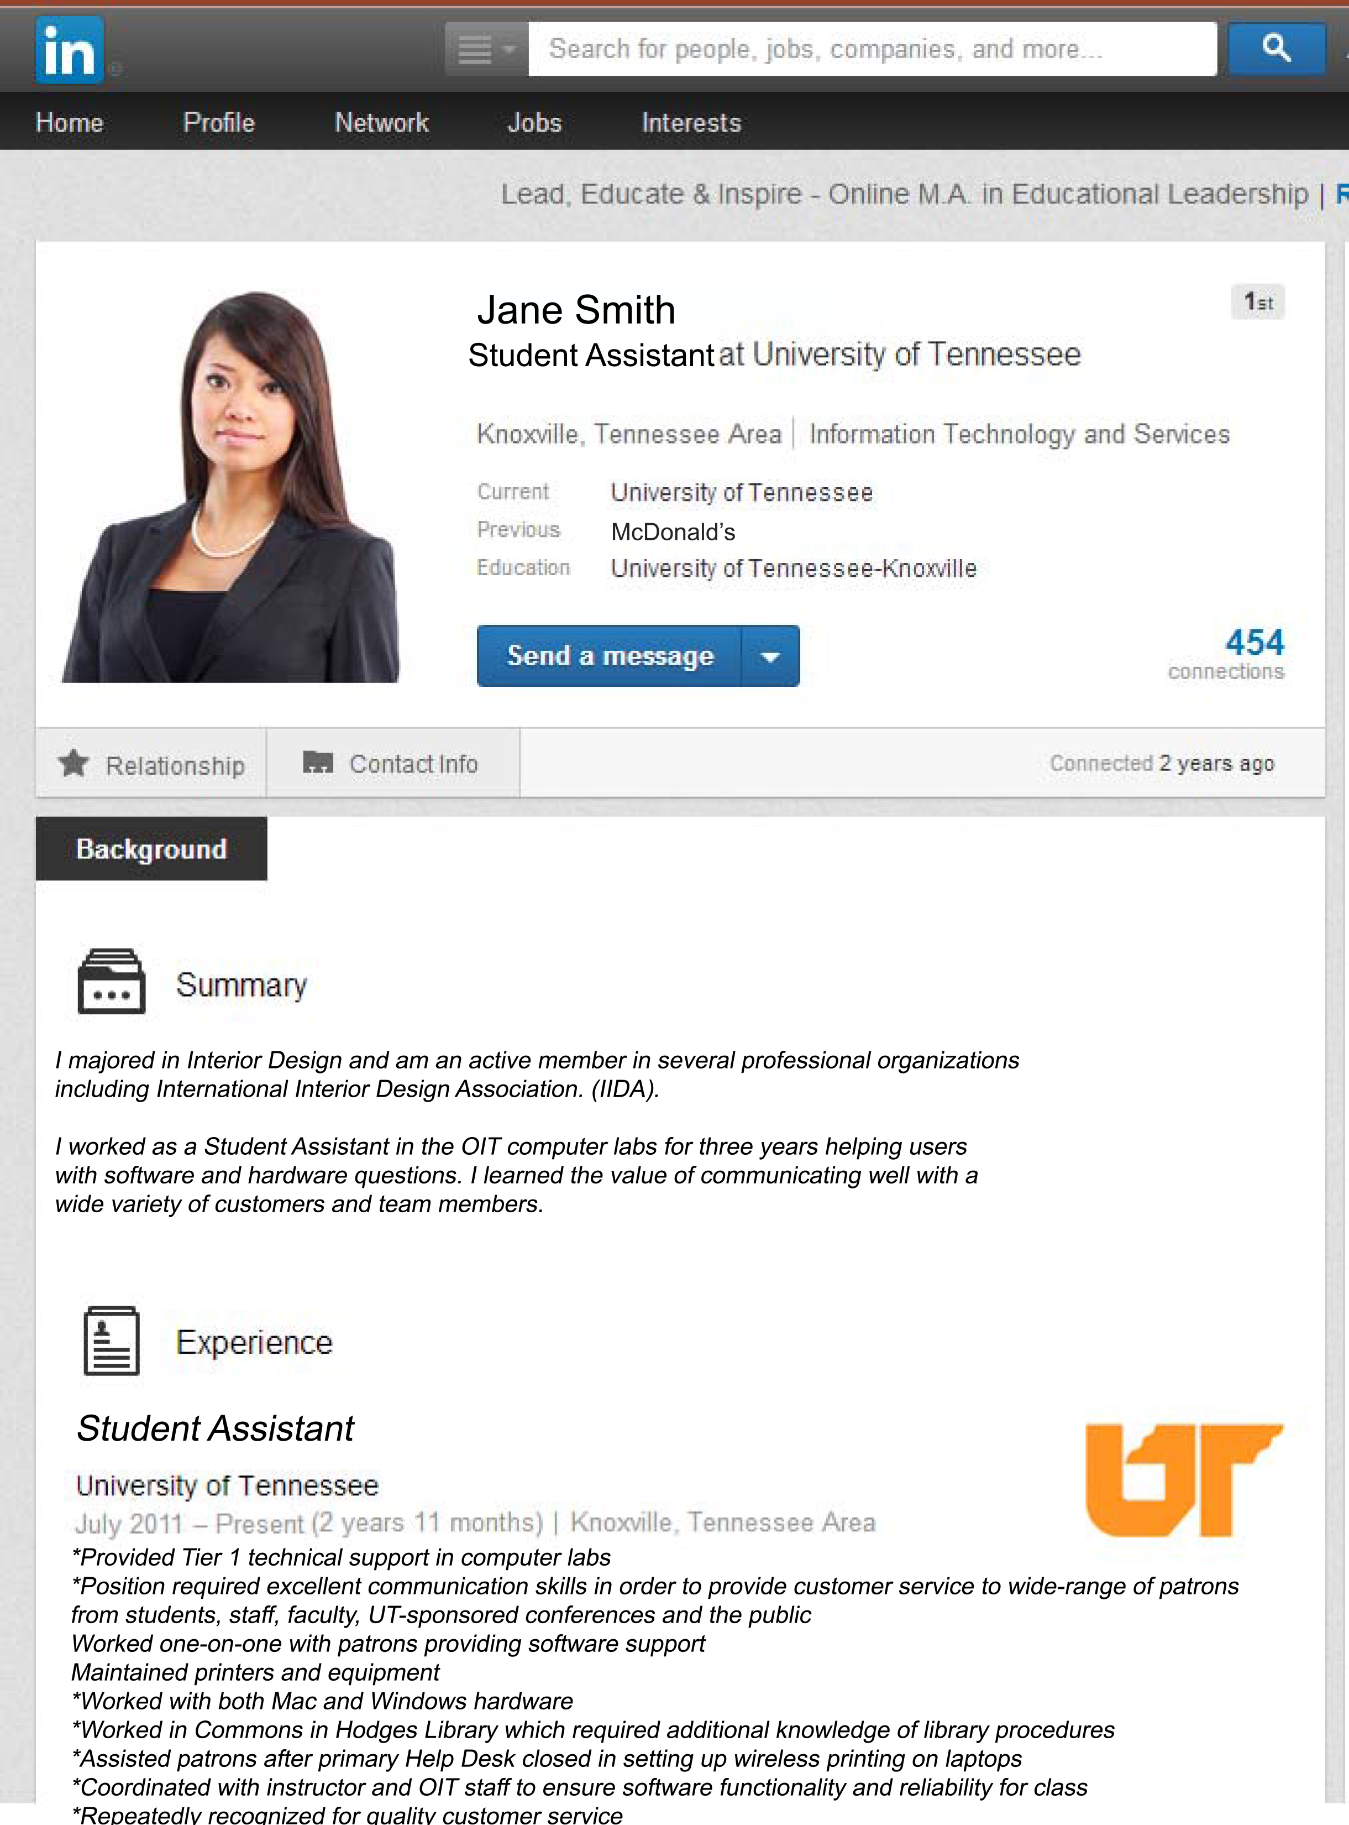
Traditional Styles (The minimum you need)
Paper
LinkedIn

Slide 12
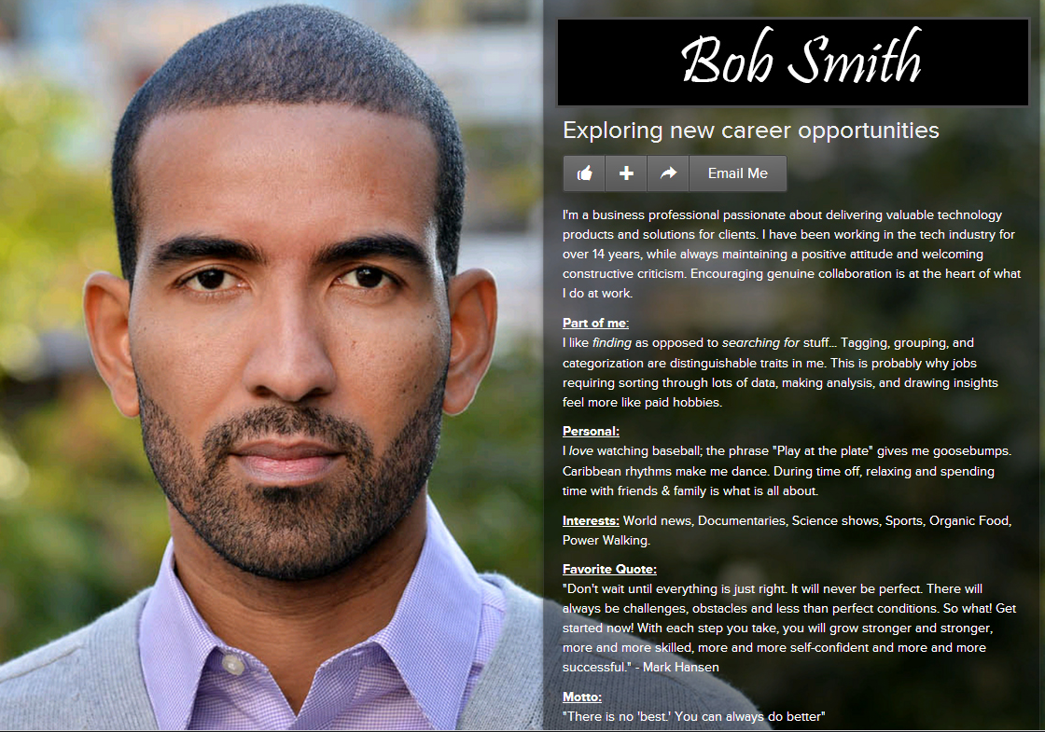
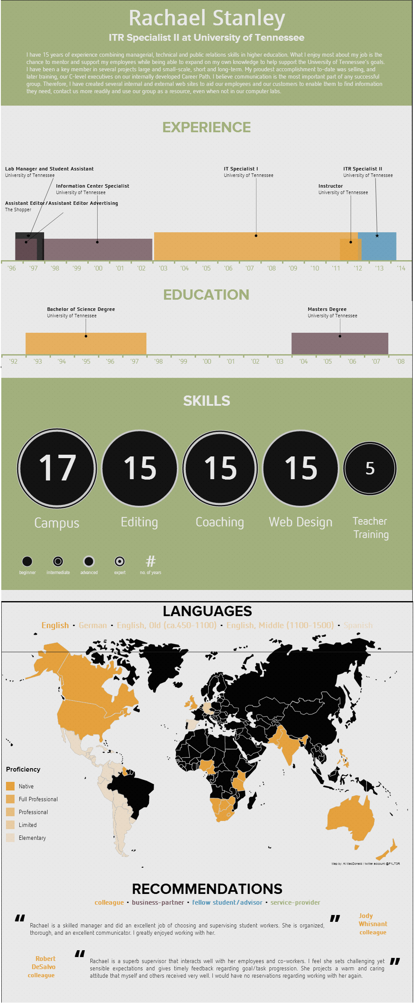



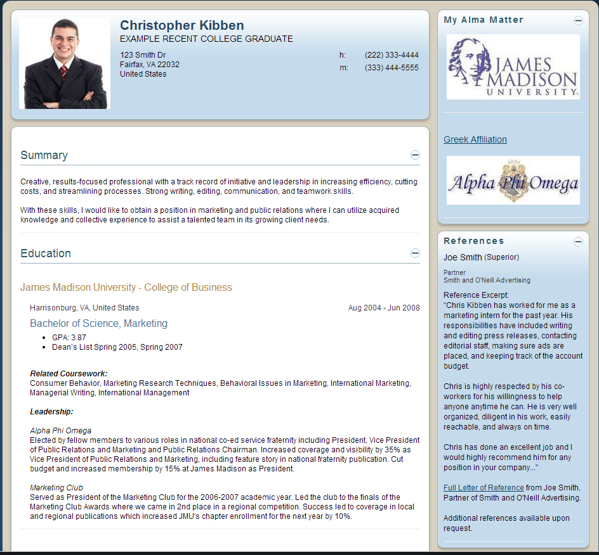
Additional
Styles
Things to
experiment with

Slide 13
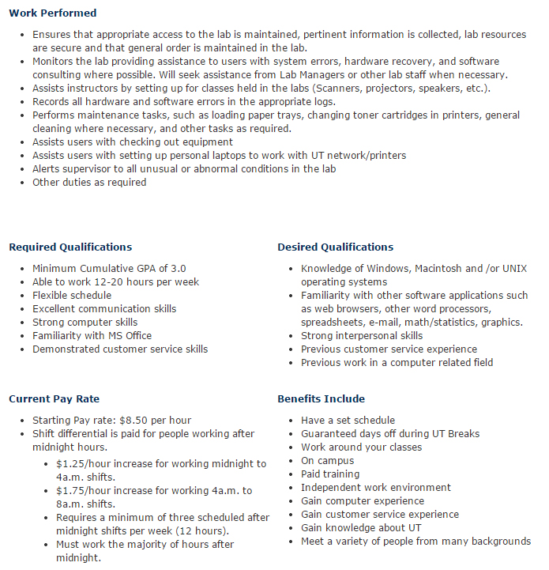
For your resume:
On the OIT web site:
  Work performed
  Required and Desired qualifications
Things not listed?
    Commons – library info
    Teaching labs –worked with professors

Slide 14

Ask yourself questions
Did I get commendations?
What were my accomplishments?

Slide 15
Resume Tips
One page*
Reverse chronological order
No competencies, objectives, career summaries
Easy to read
Don’t need complete sentences
Watch verb tense, spelling, simple mistakes
Have someone else read it first
* Exceptions for experience and going into higher ed

Slide 16
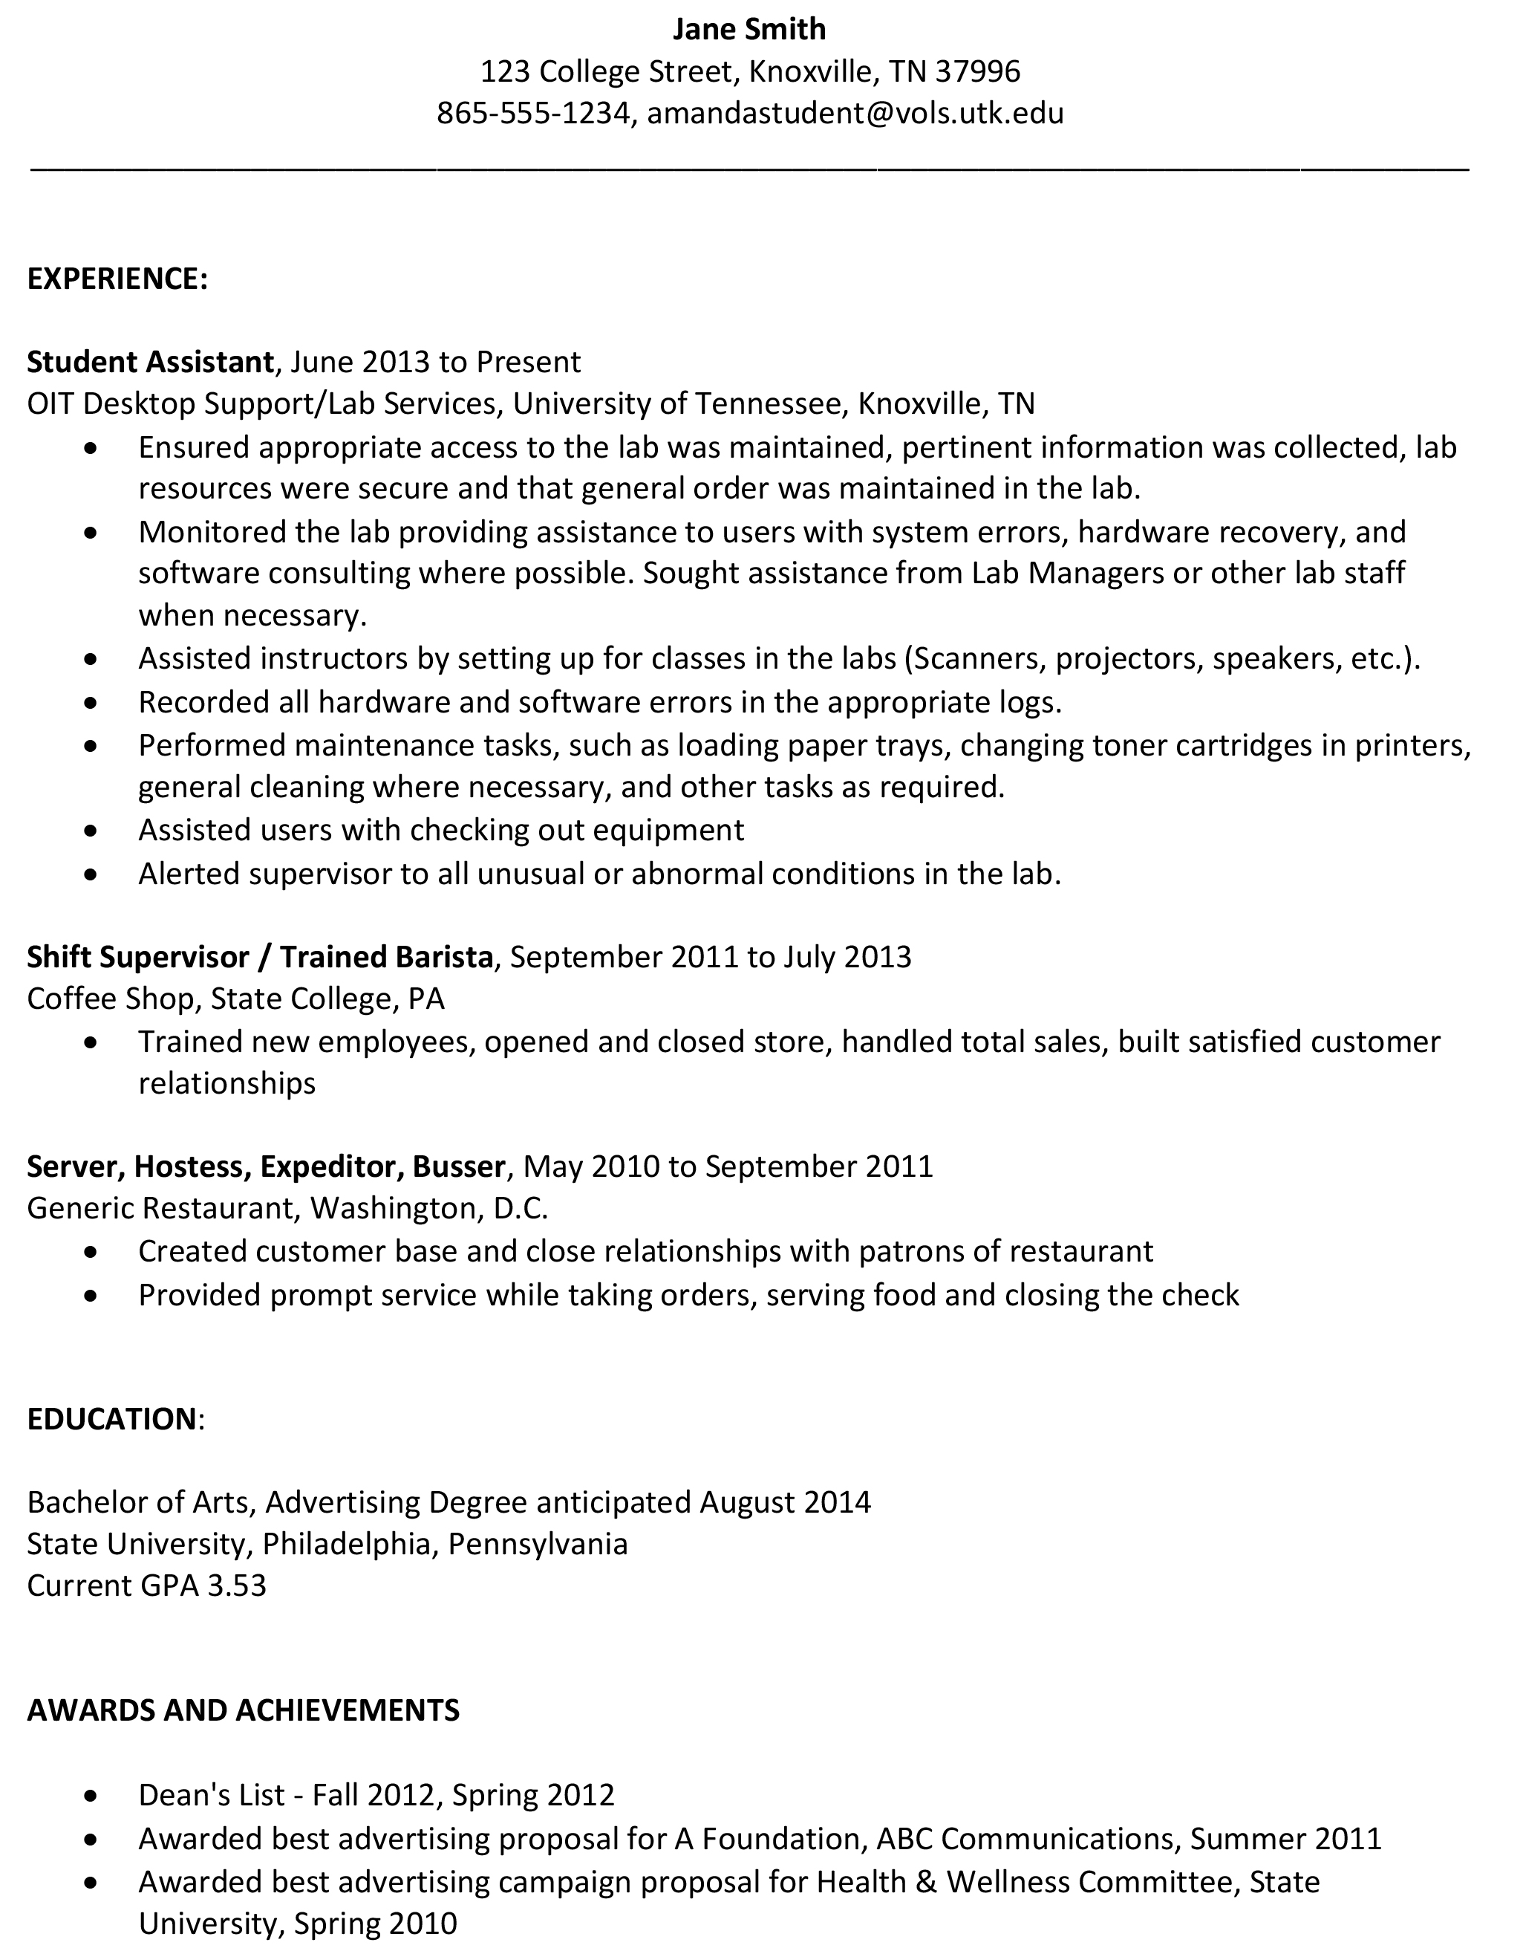
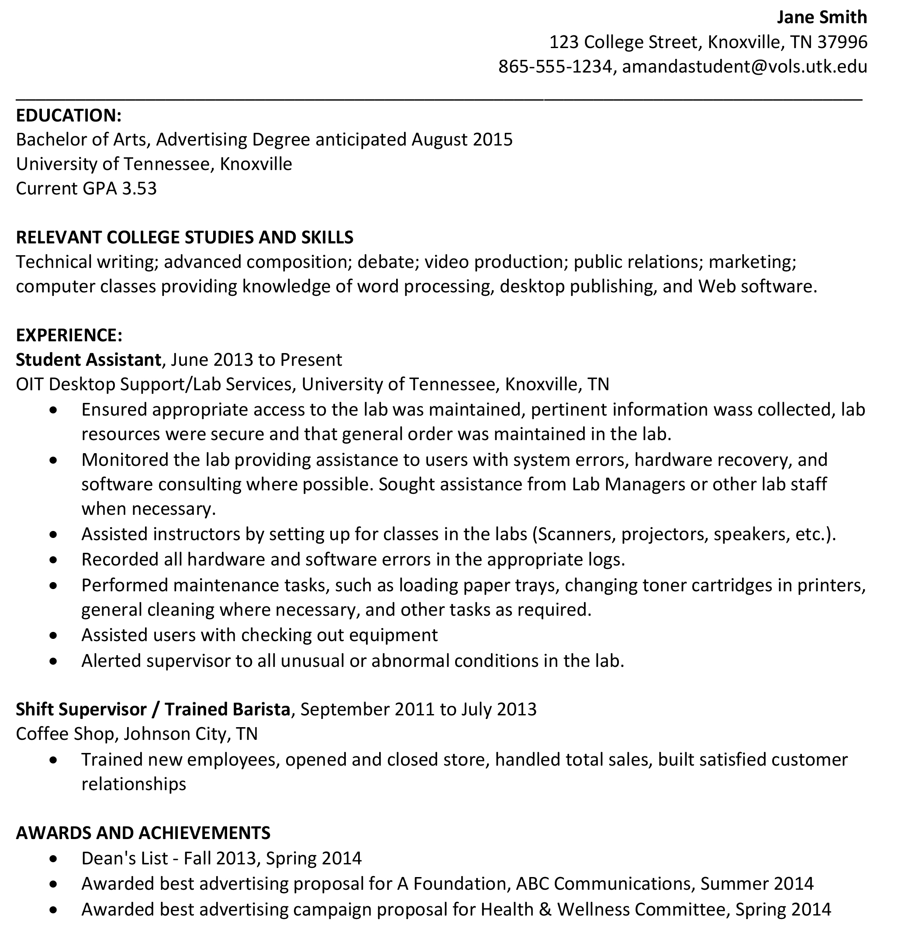
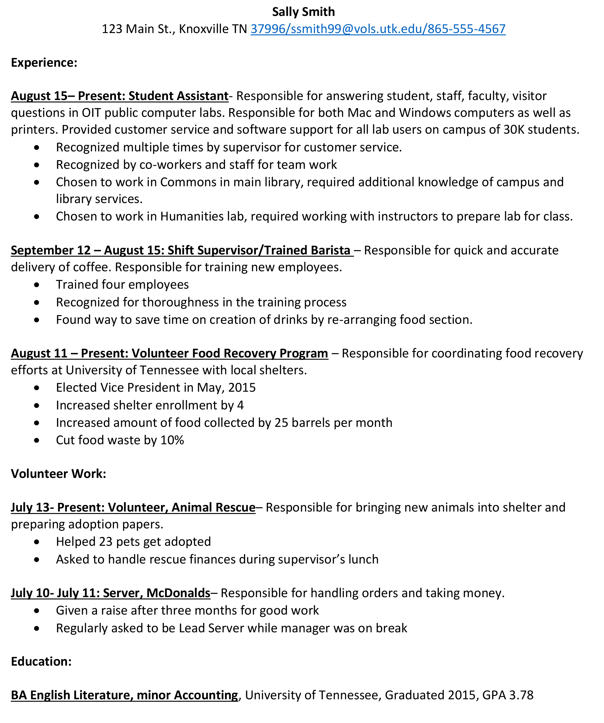
Resume: styles and needs
Highlight Experience, Title First
Highlight Education, when it applies more than job xp
Highlight Experience, Dates First

Slide 17
Asking for a reference letter
Say exactly what position you’re applying for.
Ask me to highlight certain things.
– I want a list.
Include your resume (but don’t make me read it if I don’t have to).
If asked what you want the letter to say…SAY it. People are busy.
And finally…….
If it’s a form, fill out all your information and don’t make extra work for me when I’m doing you a favor.

Slide 18
Use Social Media to create your brand

Slide 19
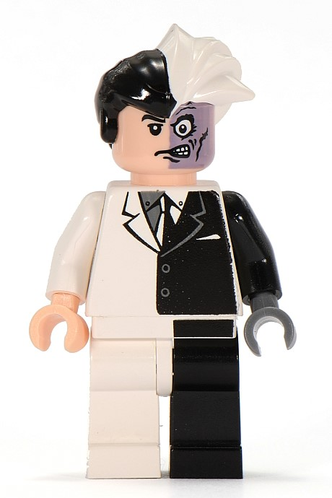
Why use Social Media Networking?
Internship opportunities
Jobs after graduation
Contacts in your field
Get ideas/Give ideas
Establish yourself as an expert
Manage your own first impression and reputation
Build confidence networking

Slide 20




Show This!
Not This!

Slide 21

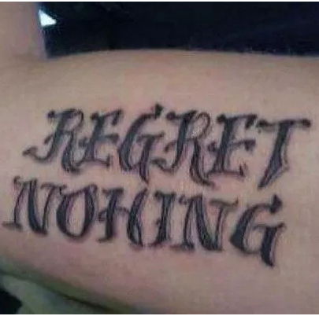
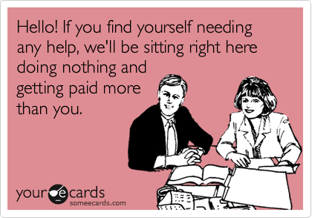
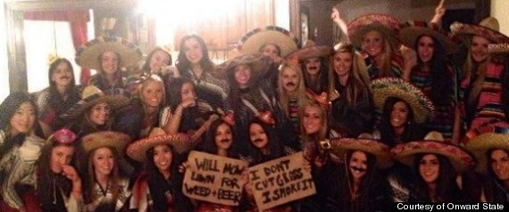
Risky or stupid behavior is not just drinking and partying
No inappropriate pics
No confessions
No risky behaviors
No discriminatory comments
Remove your friends’ discriminatory and dumb comments. You are judged by what they say
Hey employer, please increase my insurance rates!
Prove you’re dumb?
Want to be fired?
Racist much?

Slide 22

Why worry about what you post?
In many states, it is legal for an employer to require you give them your username and password to log on to social media sites

Slide 23
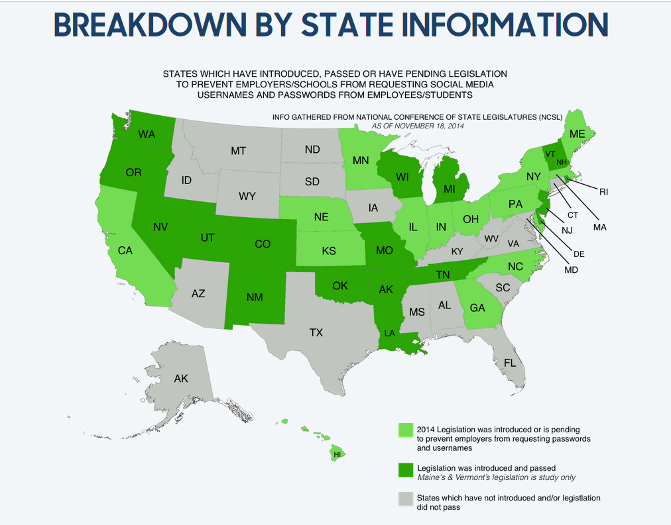
Sources: https://www.rsvplaw.com/blog/employers-want-my-social-network-passwords-is-that-legal/ and http://www.ncsl.org/research/telecommunications-and-information-technology/employer-access-to-social-media-passwords-2013.aspx

Slide 24

Warning: It’s Forever
You can be FIRED for what you post online
It never goes away (even Snapchat)
From Snapchat Privacy Policy: "In addition, as for any other digital information, there may be ways to access Snaps while still in temporary storage on recipients' devices or, forensically,
even after they are deleted."
As an aside, it’s very easy for someone to just borrow a cell phone from a friend and snap a picture of their screen – bypassing any technical blocks the software has.

Slide 25



What to do?
Stick to a handful of sites
  Be an expert there
Follow people you want to network with
Follow companies you’re interested in
  Participate in their discussions
  Find out what is important to that company
Actively manage your image

Slide 26
Facebook is for my mom!
But…companies use FB.
Just like with Twitter, you can:
Like their page
Participate on the page
Get familiar with what’s important to that company
Employers will Google you. FB is often a top result. Manage your image there for a good first impression.

Slide 27
Twitter tips
Tweet often, but not too often
Include pictures
Be a real person
Have intelligent things to say
Use humor appropriately
Watch what you say
Follow others, but not everyone
Make sure your followers are real people

Slide 28



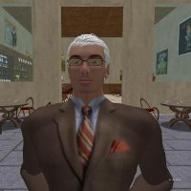

LinkedIn Don’ts
Post non-professional messages
Be annoying in discussions
Obviously self-promote
Have a bad profile pic
No Group photos or awkward crops
No picture shows you don’t care
No Avatars
Boring background, not flattering

Slide 29




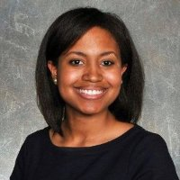
LinkedIn Do’s
Flattering, professional looking photo
Get as many REAL contacts as possible
Keep your info current
Link to papers, blogs, Twitter
Join groups and participate!
Brandon Irby
Christina Hawk
Hair combed, neat & professional clothes, close-up of face.
Background is either professional (and flattering) or colorful and makes person look interesting
Mark Chinetti
Rachael Ainsworth
Shelitha Ferraro
All these photos are of former Labs Students from their LinkedIn profiles

Slide 30






Where to look for a job?
Use reputable job search sites

Slide 31

Ways we can network now and after graduation
Professional way to stay connected and a way to connect with former SAs who are now in your field.
Social, fun things we are doing and announcements alumni might me interested in.
University of Tennessee, Knoxville
Computer Labs
UT Computer Labs

Slide 32

Questions?
Thank you!
University of Tennessee, Knoxville
Computer Labs
UT Computer Labs
@rachaelstanley

Slide 33

Bringing it all together
Use accepted professional sites
Use reputable search engines
Get an early presence on new sites
Follow companies you’re interested in

