Slide 1
Helping Grads Get Jobs
Practical tips for managers on fulfilling the Complete College Tennessee Act

Slide 2
Why is this important?
Complete College Tennessee Act requirement.
Help our students recover faster from The Great Recession.

Slide 3

Complete College
Tennessee Act
Goals:
Address the state’s research, economic and workforce development needs.
Foster economic growth by increasing STEM doctoral students at UT and other universities.
Accelerate state’s economic and workforce development in energy sciences and engineering.
Support development of clean energy technologies and jobs in TN.
Note: “Job Placements” are part of community college outcomes formula.
Source: http://tn.gov/thec/complete_college_tn/ccta_files/ccta/Pub%20Chap%203%20-%201st%20Ex%20Sess.PDF, pg 1, 6-7

Slide 4

Unemployment is down, isn’t it?
In 2015:
Unemployment Rate for nation:
Total for people 16 years and over: 6.7%
Total for Bachelor’s degree and higher: 3.4%
But……
Unemployment Rate for recent college grads:
People 22-26 years old: 7.5%
Source: Bureau of Labor Statistics News Release March 6, 2015 http://www.bls.gov/news.release/pdf/empsit.pdf
Source: “Hard Times to Better Times,” Georgetown University, Center on Education and the Workforce, 2015 report, pg. 8 https://cew.georgetown.edu/wp-content/uploads/HardTimes2015-Report.pdf

Slide 5

“A full recovery in the employment of college graduates, especially at the Bachelor’s degree level, may be as far off as 2017 and a full recovery in earnings may take longer.”
From “Hard Times to Better Times,” Georgetown University, Center on Education and the Workforce, 2015 report, pg 5 https://cew.georgetown.edu/wp-content/uploads/HardTimes2015-Report.pdf

Slide 6
Why not just send them to Career Services?
We do that too, but….
Have familiarity with specifics on the student job.
Offer more than just resume help.
Are planting the idea for them to be a resource for future students.

Slide 7
How can we help?
Be an active networking resource.
Teach job searching skills.

Slide 8
Be an active networking resource
Encourage students to connect with you on LinkedIn.
Create private networking groups.

Slide 9
Why connect on LinkedIn?
You become a hub.
Gives current students a natural introduction to former students who are now in their field.
Easy way for students to begin networking.
Easy way to keep track when students ask for references after graduation.

Slide 10


Be an active networking resource:
Create private social media groups
LinkedIn
Facebook
Gives current/former students a natural connection.
Info for references and background checks.
Place to post helpful articles or job postings.
University announcements relevant to current/former students.
Way for students to keep in touch if not on LinkedIn.
Fun things we’re doing.

Slide 11
Teach job searching skills.
Personal brands
Resume tips
Reference letters

Slide 12

Creating a personal brand:
Have a version of the branding statement for their “elevator pitch”
Support the brand by what they post online

Slide 13
Creating a personal brand:
Have students ask themselves these questions:
Who are you?
What can you do for the company?
What job are you looking for?

Slide 14
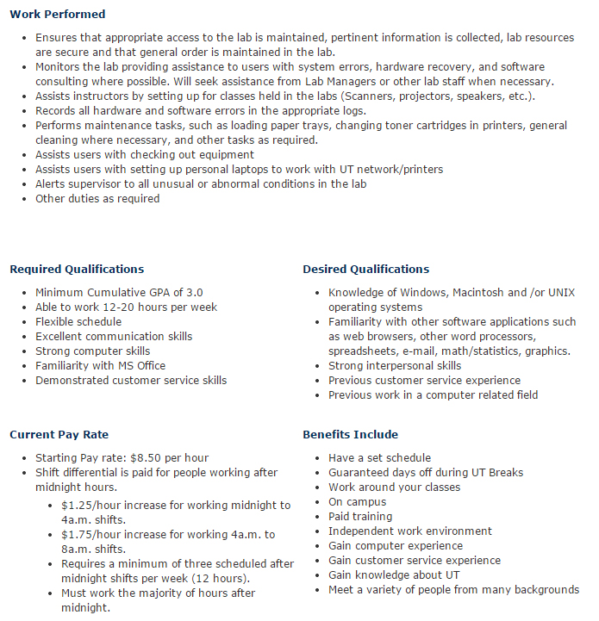
Resume tips
Do workshops with your students on writing resumes.
Have a good job description on the web as a resource.

Slide 15
Reference letters
For Students
Give information on the job you’re applying for.
Give plenty of time for your reference to write a letter.
On forms, fill out your information; make it easy on your reference.
For Managers
Give written positive feedback so you both can refer to it later.
Include good qualities and accomplishments in your student employee database for future reference letters.
Stay in contact on LinkedIn.

Slide 16
Teach responsible social media use:
Legal rights
Creating a LinkedIn presence
Posting appropriate content
Networking using social media sites
Reputable job search sites

Slide 17
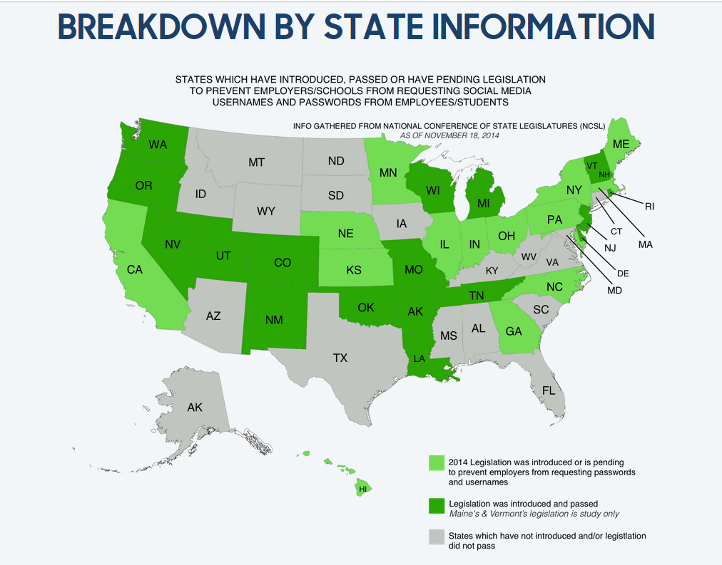
Sources: https://www.rsvplaw.com/blog/employers-want-my-social-network-passwords-is-that-legal/
Legal rights
Notes:
17 states

Slide 18


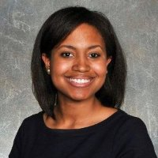



Responsible social media use:
Creating a LinkedIn Presence
Yes: Professional looking and flattering photo
Keep info current
Link to papers, blogs, and Twitter
Join groups and participate
Brandon Irby
Nocona Canady-Flatt
Shelitha Ferraro
No: Unflattering, unfinished, or oddly cropped photos
I leave things undone
I only dress up for weddings
I am not a real person

Slide 19
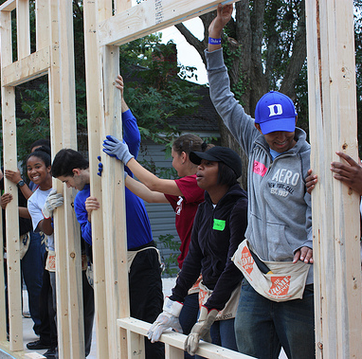


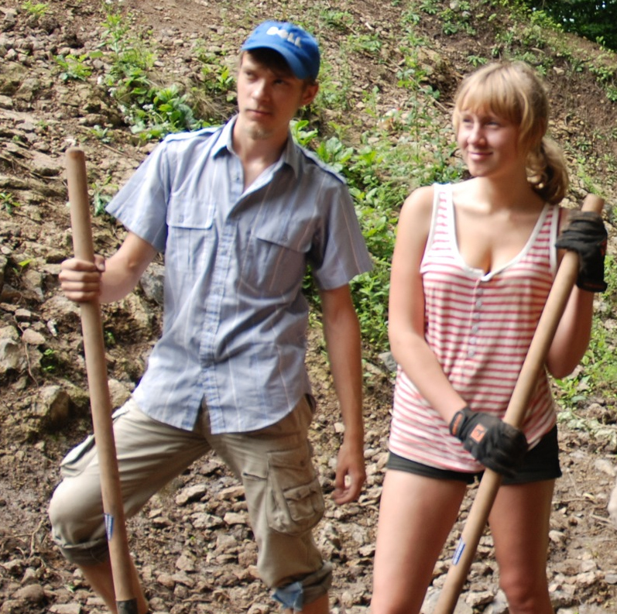
Responsible social media use:
Posting appropriate content on other sites
Not This
No risky or stupid behavior
Show This

Slide 20

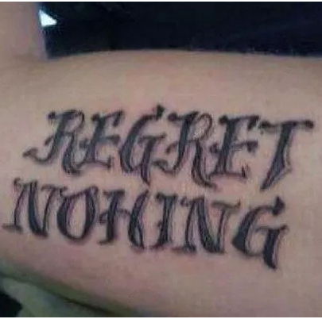
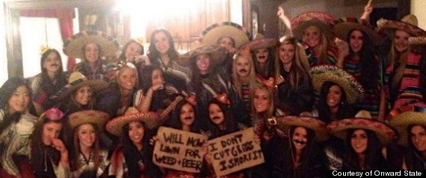

Responsible social media use:
Risky or stupid behavior is not just partying
Hey employer, please increase my insurance rates!
Prove you’re dumb?
Racist much?
No inappropriate pics
No confessions
No risky behaviors
No discriminatory comments
Remove friends’ discriminatory comments.
You are judged by what they say
Want to be fired?

Slide 21



Networking using social media sites
What to teach your students:
Stick to a handful of sites
  Be an expert there
Follow people you want to network with
Follow companies you’re interested in
  Participate in their discussions
  Find out what is important to that company
Actively manage your image
And yes, use Facebook and Twitter, because companies use them!

Slide 22






Reputable job search sites

Slide 23
Bringing it all together:
Be an active networking resource:
Create social media groups for current and former students
Give written positive feedback
Encourage students to connect with you on LinkedIn
Teach job
searching skills:
Personal brands
Resume tips
Asking for references
Creating a LinkedIn & social media presence
Posting appropriate content
Job search engines

Slide 24


Questions?
Thank you!
rachael@utk.edu
@rachaelstanley

